Slide 1

TJS ENGINEERING COLLEGE (Approved by AICTE&Affiliated to Anna University Chennai & Accredited by NAAC) An ISO 9001 : 2015 Certified Institution
DEPARTMENT OF COMPUTER SCIENCE AND ENGINEERING
Project name : Smart Water Management
Team name : Proj_112821_team_3
Team members :
Sathish Kumar.S(112821104063)
Sai Kumar.S(112821104056)
Venkatesh.M(112821104072)
Yogesh.S(112821104076)
Srikanth.K(112821104068)

Slide 2
PROBLEM DEFINITION:
The project involves implementing IoT sensors to monitor water consumption in public places such as parks and gardens. The objective is to promote water conservation by making real-time water consumption data publicly available.
This project includes defining objectives,designing IoT sensor system developing the data sharing platform and integrating them using IoT technology and python.

Slide 3
OBJECTIVES:
The smart water system using IoT is an innovative solution that leverages the IoT for management and conservation of water resources.
Water management problems such as water usage ,overflow in water tank. To overcome this problem by implementing proper monitoring.
Through a network of sensors, the system collects real-time data on water quality and consumption. This data is processed in cloud based platform.
It highlights potential of IoT in revolutionizing water management practices, ensuring sustainable access to clean water for current and future generations.

Slide 4
EXISTING SYSTEM:
Manual Meter Reading: Water consumption is often monitored through traditional meters that require physical visits by utility personnel to read and record usage. This can be time-consuming and prone to errors.
Water Quality Monitoring: Water quality monitoring is typically periodic and may not detect issues until they have reached critical levels. Contaminants and impurities may not be detected until after they have affected water quality.
Limited Data Analysis: Data collected from the existing system may not be analyzed comprehensively to identify trends, predict maintenance needs, or optimize resource allocation.

Slide 5
PROPOSED SYSTEM:
IoT Sensors and Devices:
Deploy a network of IoT sensors and devices throughout the water distribution network, including water treatment plants, reservoirs, pipelines, and consumer premises.
These sensors will continuously monitor parameters such as water flow rate, pressure, temperature, pH levels, turbidity, and contaminants.
Real-time Data Collection:
Collect real-time data from the sensors and devices, providing a comprehensive view of the entire water system's status.
Use wireless communication protocols (e.g., LoRaWAN, NB-IoT) to transmit data securely and efficiently.

Slide 6
IoT SENSOR DESIGN:
There are several IoT sensors and components that are used in the smart water system using IoT. Some of them are as follows.
1.Ultrasonic sensor: It is used to indicate the level of water in real time. When the water level falls below the threshold level the motor will automatically ON.
2. Temperature sensor: It is used to sense the temperature in water tank.
3. Water flow Sensor: It is used to know the usage of water litre per hour. By using ESP8266 WI-FI module the data is recorded in real-time and updated in cloud.

Slide 7
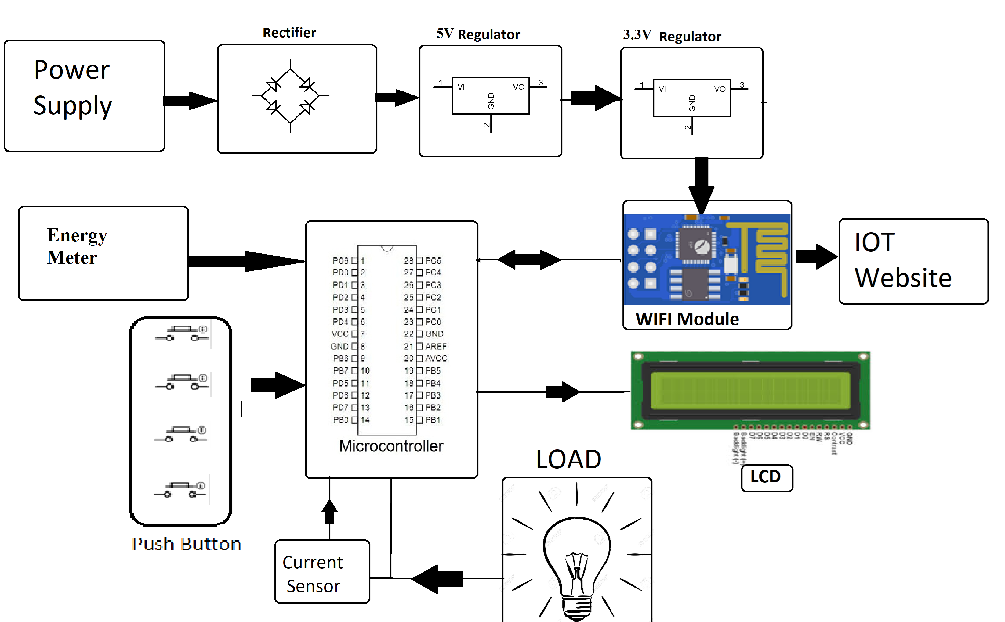

Slide 8
REAL-TIME TRANSIST INFORMATION PLATFORM:
The Smart Water Transit Information Platform (SWTIP) is a digital ecosystem that leverages real-time data and IoT technology to provide critical information and services related to water distribution and management
Real-Time Water Flow Monitoring: Provides real-time data on water flow rates, pressures, and distribution within the water network. Users can track the movement of water in pipes and pipelines.
Water Quality Monitoring: Monitors water quality parameters such as pH levels, turbidity, and contaminants in real time, with alerts for potential issues or breaches in quality standards.

Slide 9
INTEGRATION APPROACH:
1. Standardize Communication Protocols:
Ensure that all devices and software components use standardized communication protocols for seamless data exchange. Common IoT communication protocols include MQTT, CoAP, and HTTP/HTTPS.
2. Central Data Platform:
Establish a central data platform or data hub that serves as the backbone of the system. This platform should aggregate and store data from various sources and provide APIs for data access.
3. IoT Device Management:
Implement an IoT device management system to handle device provisioning, monitoring, and firmware updates. This ensures that all devices are functioning optimally.

Slide 10
INTEGRATION BENEFITS:
Seamless Data Flow: Integration ensures a smooth and continuous flow of data between various components of the system, allowing real-time information to be collected, processed, and acted upon promptly.
Improved Decision-Making: Integrated data from multiple sources provides a comprehensive view of the water system, enabling better-informed decision-making by utilities, operators, and other stakeholders.
Efficient Resource Allocation: Integration helps optimize resource allocation by providing insights into water usage patterns, enabling utilities to allocate water resources more efficiently and reduce wastage.

Slide 11
THANK YOU

